Slide 1
MMV Calculations
 | DALYs averted |  |  |  |  |  |  |  | Doses/Treatments
year | SPAQ | AL dispersible | ASAQ | ASMQ | DHA-P | AS-PYR | InjAS | RAS | SPAQ | AL dispersible_doses | ASAQ_doses | ASMQ_doses | DHA-P_doses | AS-PYR_doses | InjAS_doses | RAS_doses
2011 | 0.0 | 0.0 | 0.0 | 0.0 | 0.0 | 0.0 | 0.0 | 0.0 | 0 | 1E+08 | 62000000 | 0 | 0 | 0 | 0 | 0
2012 | 0.0 | 0.0 | 0.0 | 0.0 | 0.0 | 0.0 | 1,062,171.3 | 0.0 | 0 | 71000000 | 83000000 | 0 | 0 | 0 | 5490000 | 0
2013 | 0.0 | 0.0 | 0.0 | 0.0 | 0.0 | 0.0 | 1,160,842.9 | 0.0 | 0 | 32037905 | 90000000 | 0 | 0 | 0 | 6000000 | 0
2014 | 0.0 | 0.0 | 0.0 | 0.0 | 0.0 | 0.0 | 4,643,371.7 | 0.0 | 0 | 61599798 | 72000000 | 0 | 0 | 0 | 24000000 | 0
2015 | 125,675.9 | 0.0 | 264,004.8 | 0.0 | 0.0 | 0.0 | 3,269,707.5 | 0.0 | 12000000 | 65795417 | 50000000 | 0 | 0 | 0 | 16900000 | 0
2016 | 792,179.0 | 0.0 | 227,044.2 | 1,596.9 | 0.0 | 0.0 | 4,759,436.6 | 37,172.3 | 73162297 | 0 | 43000000 | 200000 | 0 | 0 | 24599900 | 69862
2017 | 711,675.0 | 0.0 | 264,004.8 | 2,235.7 | 6,554.8 | 0.0 | 5,504,508.2 | 180,157.7 | 68474056 | 71164931 | 50000000 | 280000 | 11190105 | 0 | 28450920 | 338590
2018 | 922,661.2 | 0.0 | 132,002.4 | 2,634.9 | 1,847.8 | 90.1 | 6,187,737.7 | 353,218.5 | 87213436 | 53126768 | 25000000 | 330000 | 3154521 | 50000 | 31982300 | 663842
2019 | 1,129,689.1 | 0.0 | 132,002.4 | 1,373.3 | 7,824.0 | 1,045.7 | 5,856,900.6 | 816,963.2 | 1.13E+08 | 8525000 | 25000000 | 172000 | 13356669 | 580000 | 30272316 | 1535408
2020 | 1,974,688.9 | 0.0 | 79,201.5 | 1,700.7 | 12,422.1 | 2,073.4 | 7,913,079.2 | 611,590.1 | 1.82E+08 | 74720000 | 15000000 | 213000 | 21206351 | 1150000 | 40900000 | 1149428
2021 | 1,979,437.0 | 0.0 | 132,002.4 | 798.5 | 3,573.2 | 1,081.8 | 8,979,250.0 | 2,076,914.5 | 1.9E+08 | 40760000 | 25000000 | 100000 | 6100000 | 600000 | 46410672 | 3903372
2022 | 2,109,266.3 | 0.0 | 14,256.3 | 545.3 | 2,881.3 | 5,814.3 | 9,827,562.0 | 909,512.5 | 2.02E+08 | 21940000 | 2700000 | 68290 | 4918740 | 3224856 | 50795307 | 1709346

Slide 2
Global Malaria burden
Focus on top 15 countries

Slide 3
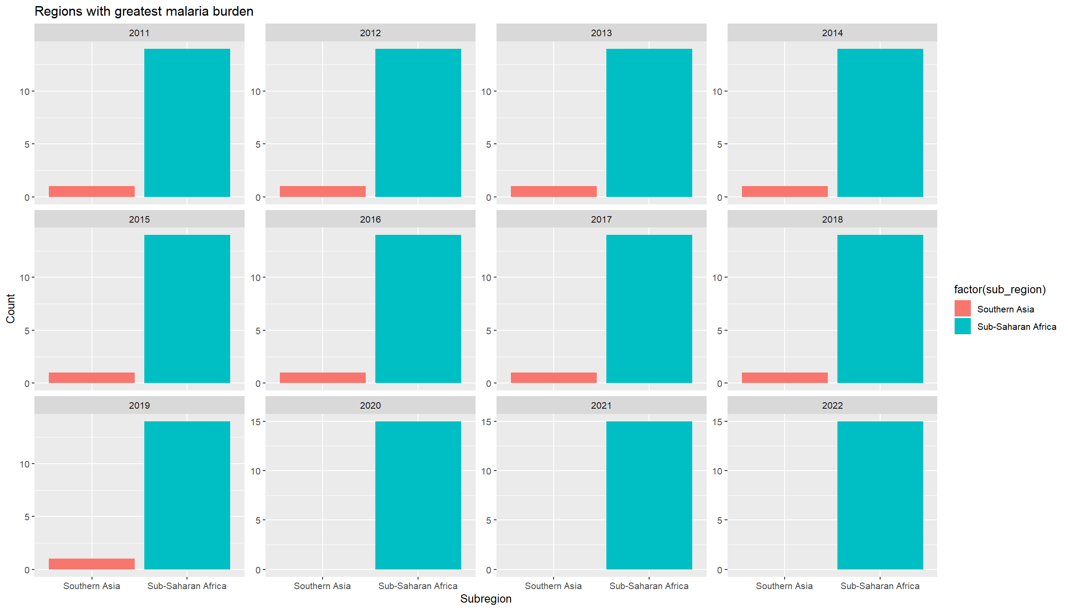

Slide 4
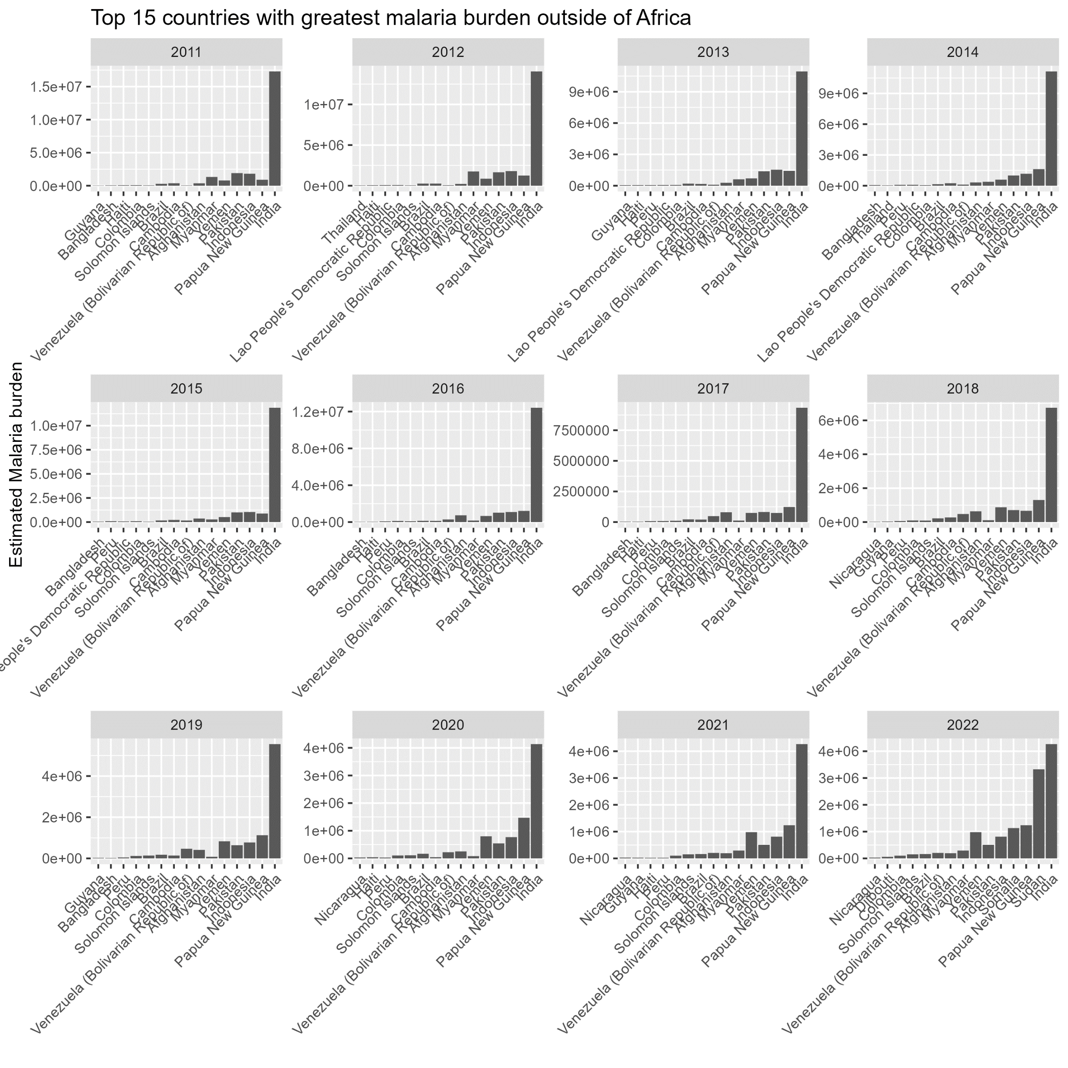
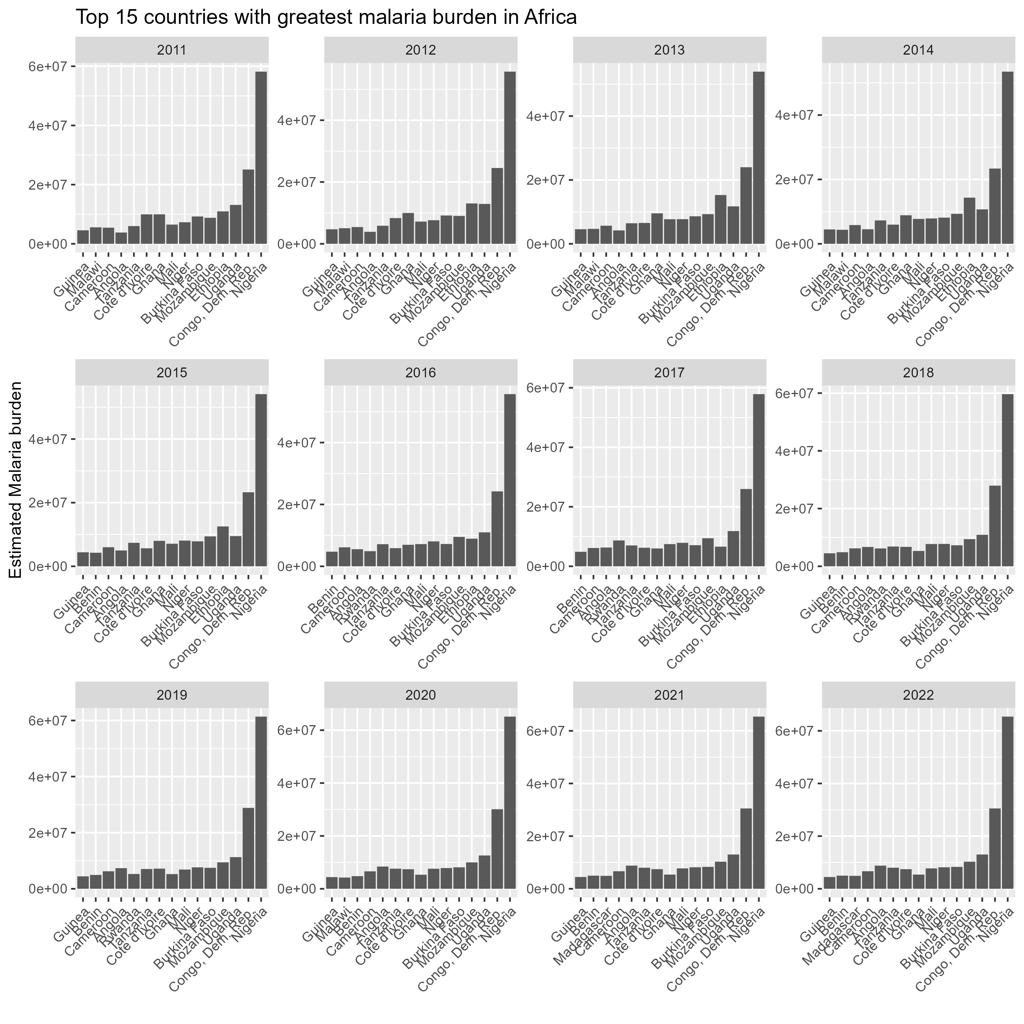
Markets for: ASAQ & SPAQ
Markets for: AS-PYR & ASMQ

Slide 5
Treatment cost data
Global Fund Data (provided by CA)

Slide 6
Product availability
(based on Unit Costs
Database)
Product | Market
AL disp | Africa; Asia
AS-PYR | Asia
ASAQ | Africa
ASMQ | Asia
DHA-P | Africa; Asia
InjAS | Africa; Asia
SPAQ | Africa
RAS | Africa; Asia

Slide 9
Outliers are in Melanesia

Slide 10
Delivery cost data
WHO CHOICE Prices (2010)
By country
Predicted mean value; standard deviation; mean value from sample; high/low 95% uncertainty interval

Slide 11
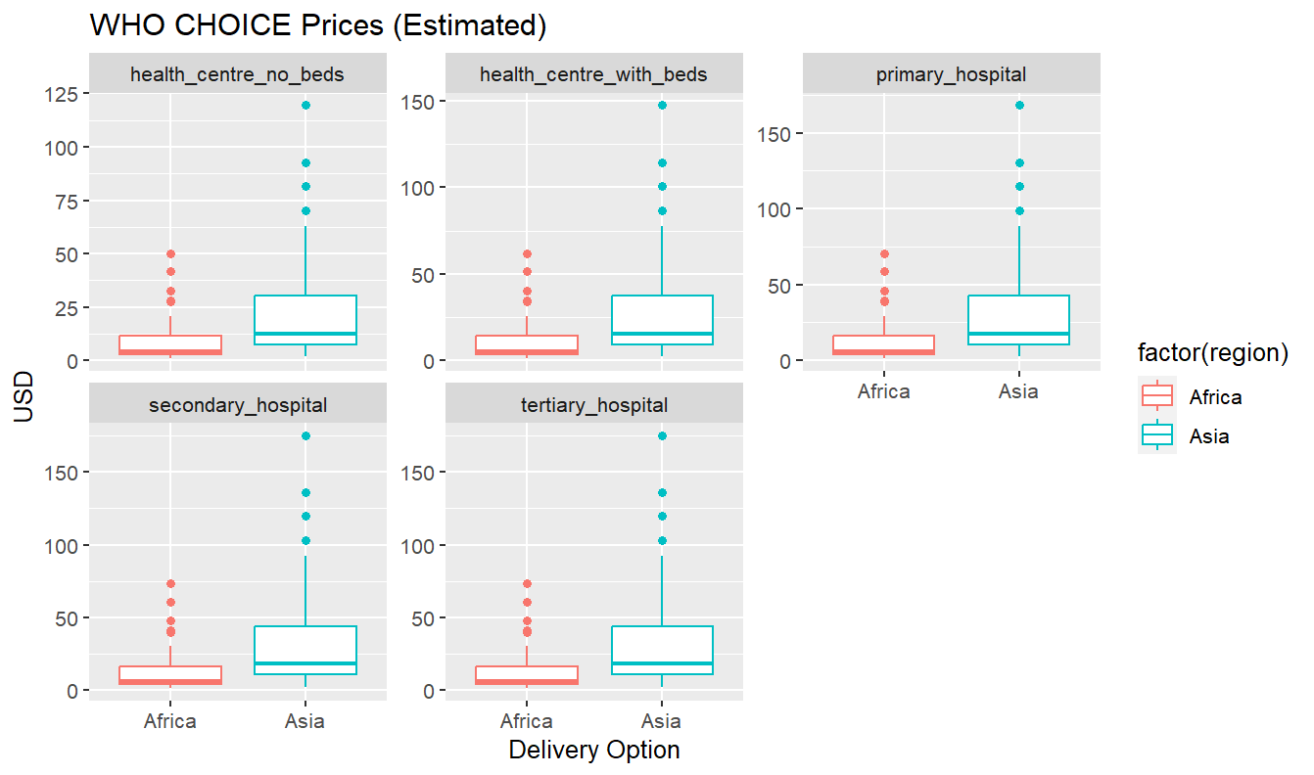

Slide 12
DALYs Monetized
Ochalek et al, 2018 (2015 prices)
https://gh.bmj.com/content/3/6/e000964.long#DC1 (Suppl. Table 1 for country specific estimates)
By country
Four methods

Slide 13
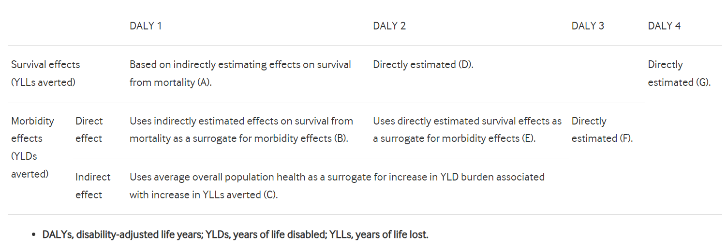
Methods to calculate health opportunity costs (measuring cost per DALY)

Slide 14
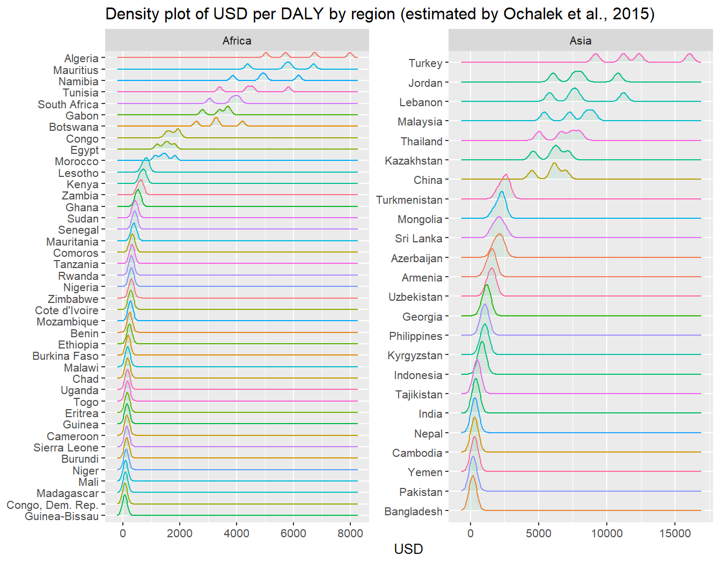
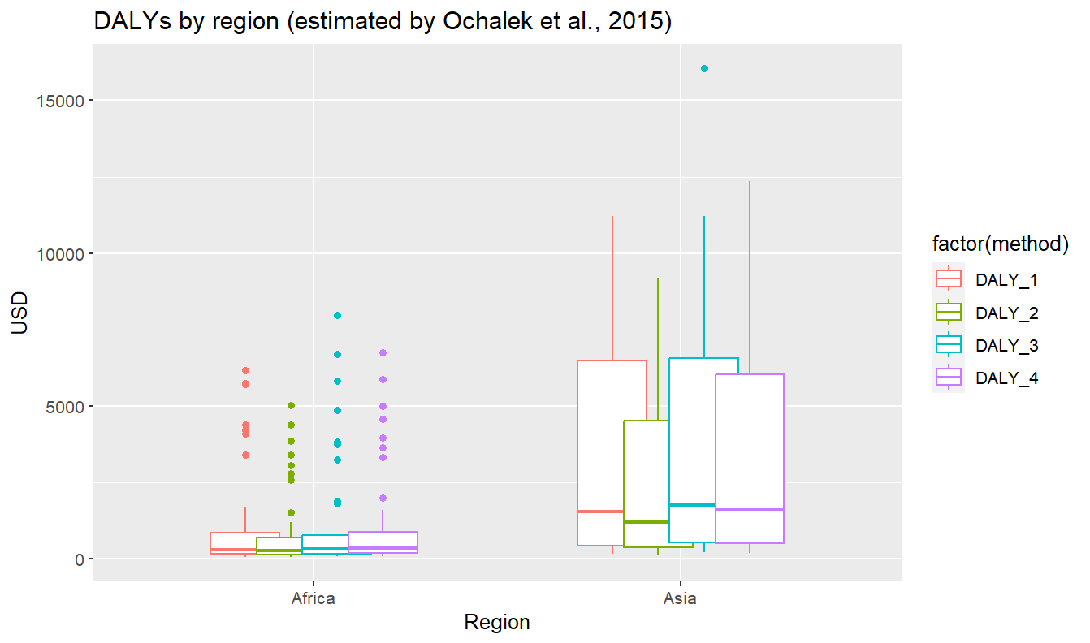

Slide 15
Final Results
23 May 2024

Slide 16
Data processing
Outliers (+ 2 standard deviations) removed from dataset.
Missing data and small n (<2) is imputed by the sub regional and regional mode.
Treatment distribution is informed by regional coverage.
Assumptions:
Mark up rates on delivery: 55%
Mark up rate on treatment: 80%

Slide 17
Sensitivity Analysis
Four key parameters were identified for probabilistic sensitivity analysis (PSA):
Health opportunity costs (monetized DALYs)
Treatment price
Rapid diagnostic test price
WHO delivery costs
Each parameter was assigned a beta-PERT distribution for probabilistic sampling, with the bounds determined by:
Empirical data for treatment price,
Empirical data for rapid diagnostic test prices
Confidence intervals estimated from WHO Choice data
1000 independent parameter sets were drawn four times (for each method used to calculate health opportunity costs), and 95% uncertainty intervals (UIs) were extracted of the sample results obtained.

Slide 18
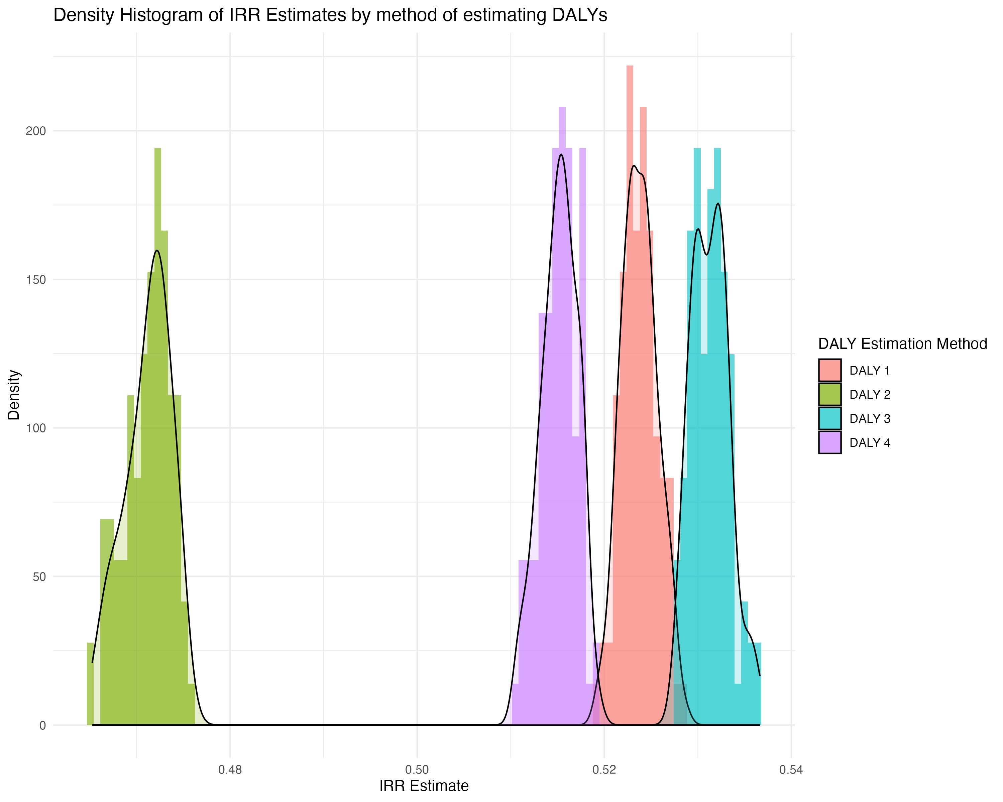
Final RoR Estimates
Scenario: Relative_All AL disp
Method | Mean | Lower 95% CI | Upper 95% CI
Overall | 51.04% | 50.81% | 51.27%
DALY 1 | 52.38% | 52.34% | 52.41%
DALY 2 | 47.12% | 47.07% | 47.17%
DALY 3 | 53.13% | 53.09% | 53.17%
DALY 4 | 51.52% | 51.48% | 51.56%
Notes:
Comparison to PC
Return on investment in $
What is ours in $
How did they value the DALYs

Slide 19
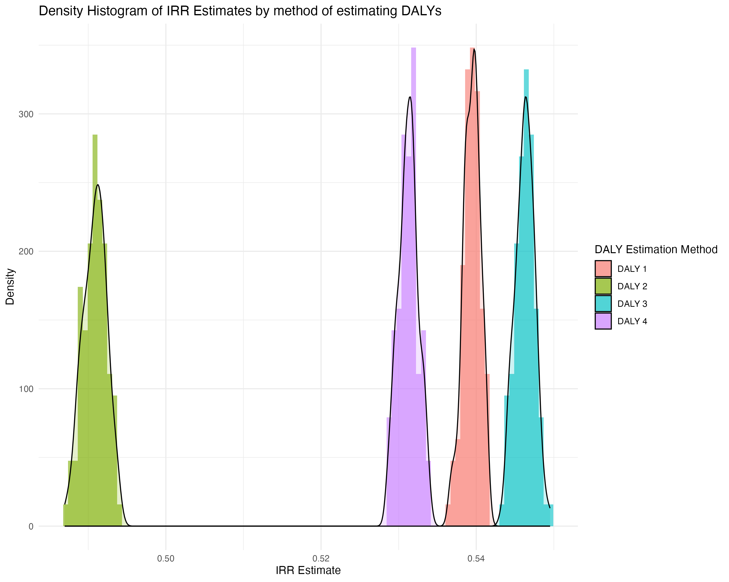
Final RoR Estimates
Scenario: Relative Coartem disp only
Method | Mean | Lower 95% CI | Upper 95% CI
Overall | 52.69% | 52.48% | 52.91%
DALY 1 | 53.94% | 53.92% | 53.96%
DALY 2 | 49.08% | 49.05% | 49.11%
DALY 3 | 54.63% | 54.60% | 54.65%
DALY 4 | 53.12% | 53.10% | 53.15%

Slide 20
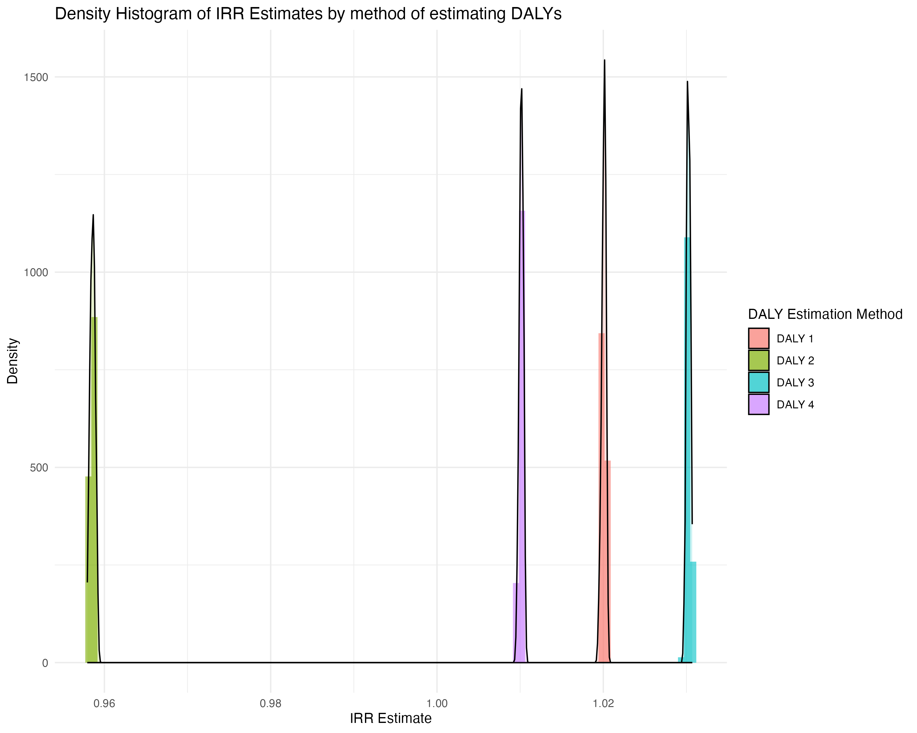
Final RoR Estimates
Scenario: Absolute All AL disp
Method | Mean | Lower 95% CI | Upper 95% CI
Overall | 100.48% | 100.20% | 100.75%
DALY 1 | 102.01% | 102.00% | 102.01%
DALY 2 | 95.86% | 95.85% | 95.86%
DALY 3 | 103.02% | 103.02% | 103.03%
DALY 4 | 101.01% | 101.01% | 101.02%

Slide 21
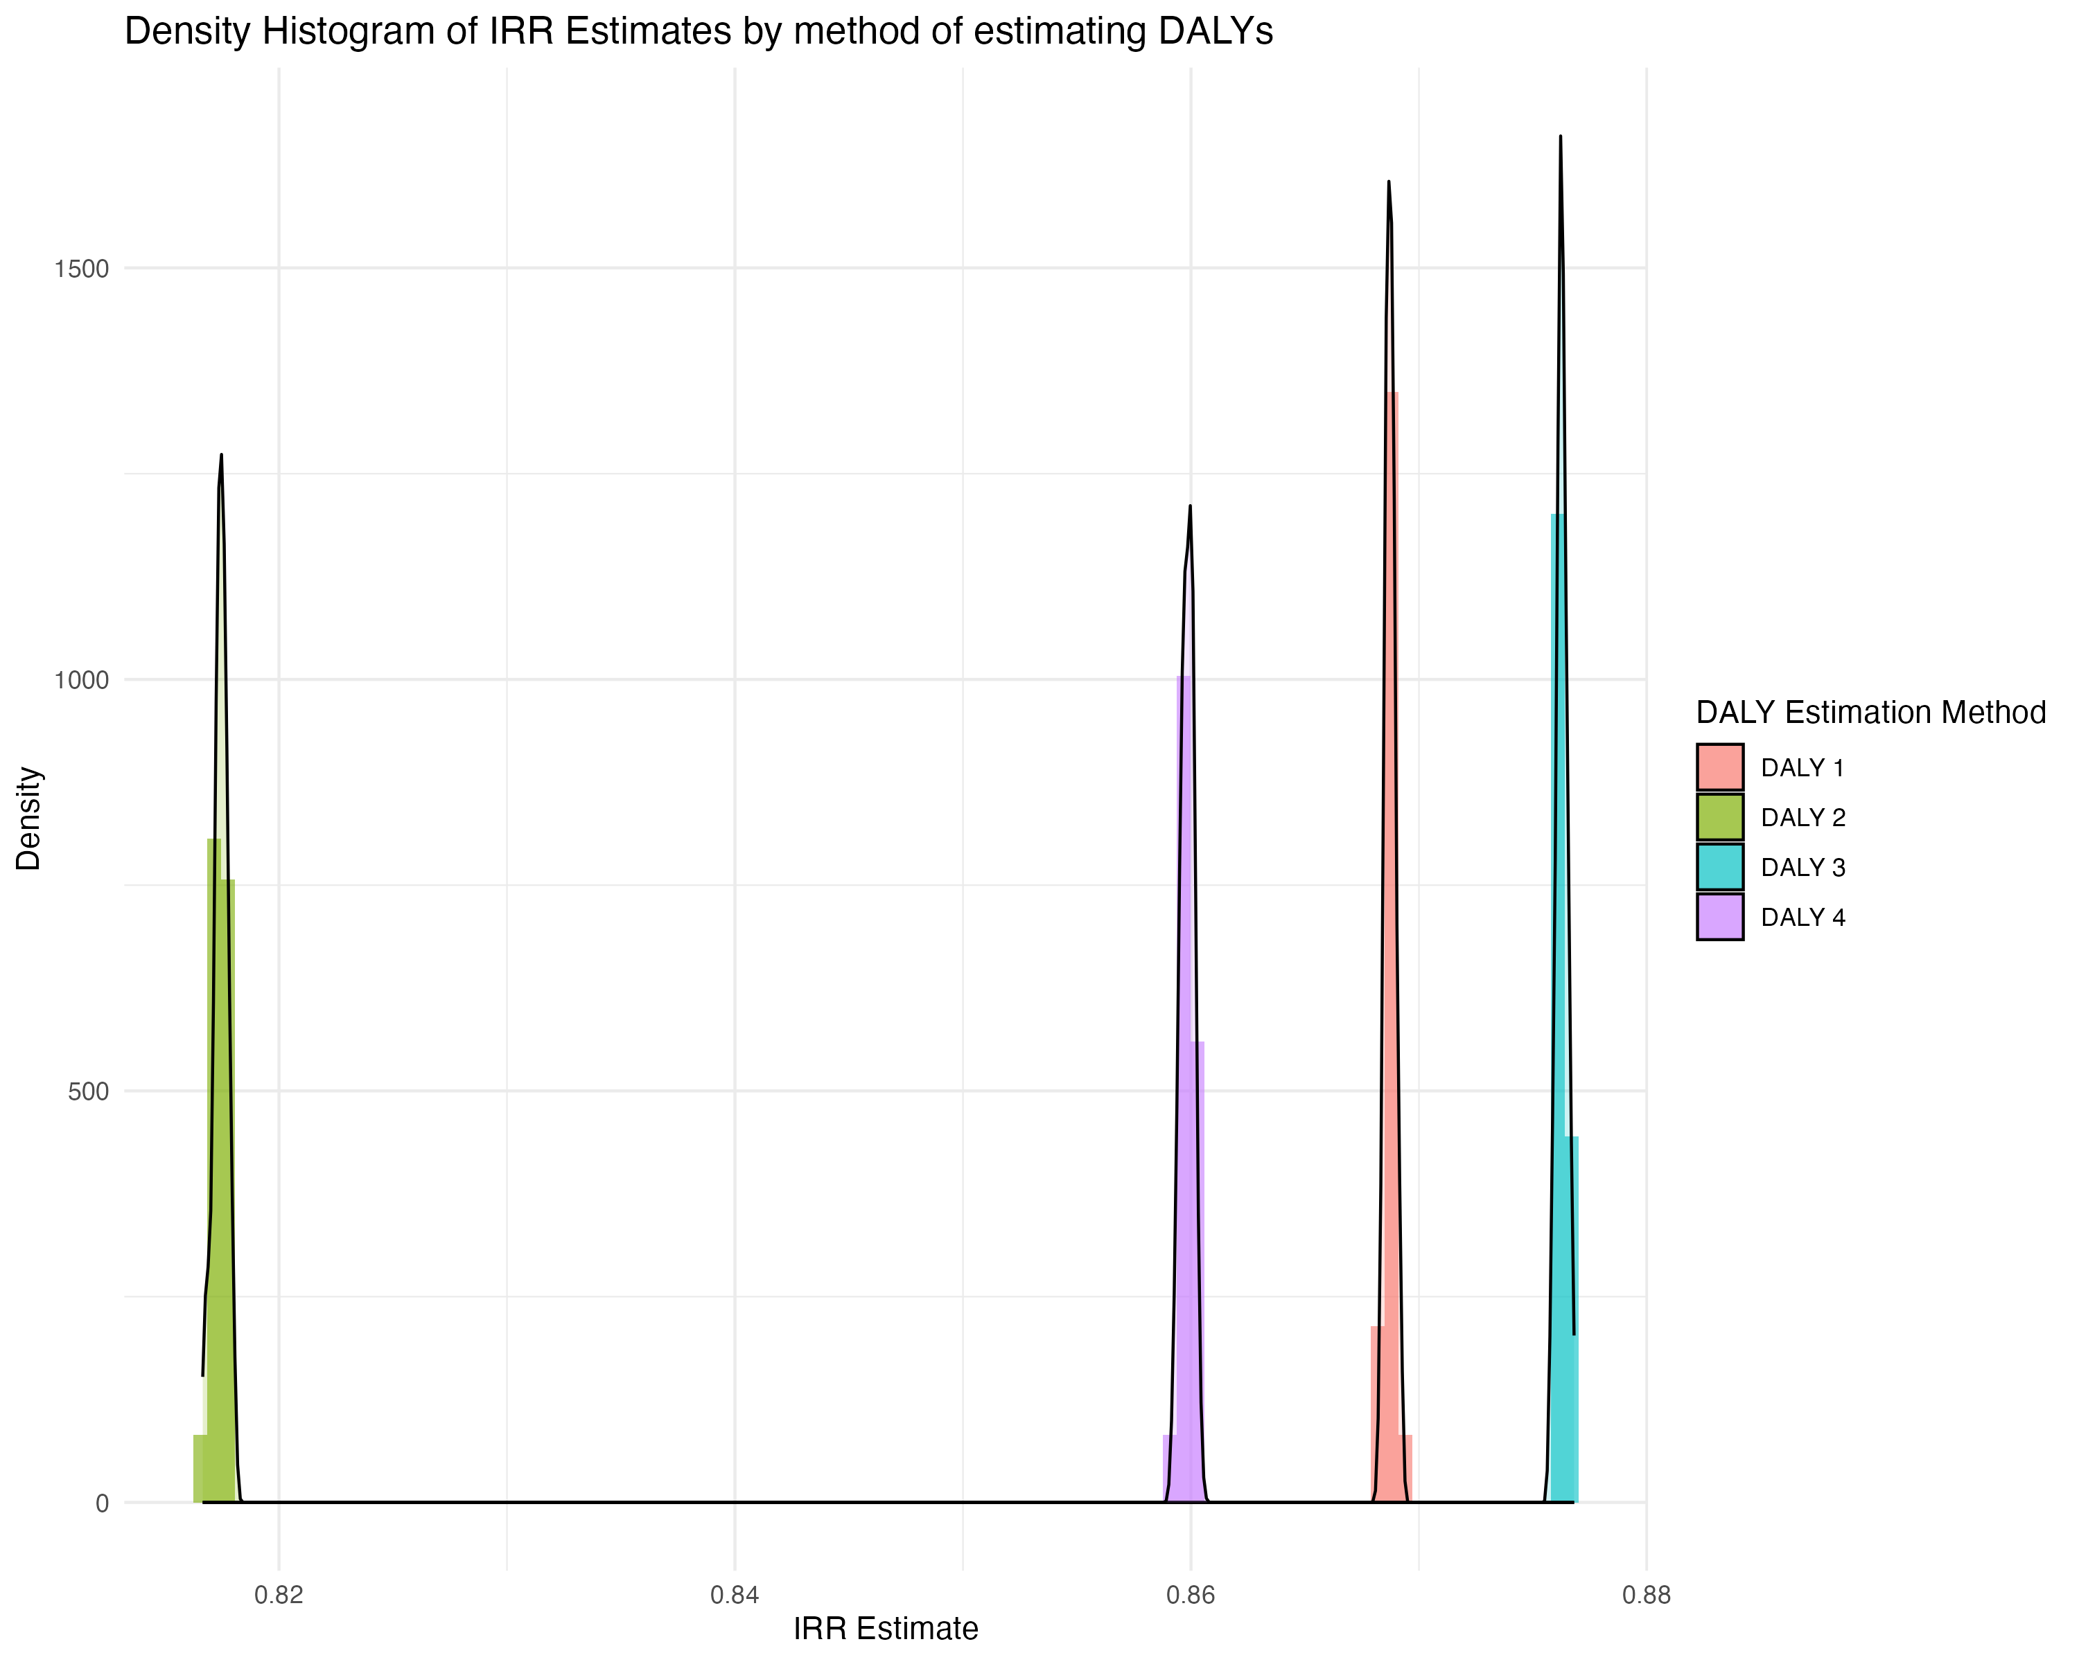
Final RoR Estimates
Scenario: Absolute Coartem disp only
Method | Mean | Lower 95% CI | Upper 95% CI
Overall | 85.56% | 85.33% | 85.78%
DALY 1 | 86.87% | 86.87% | 86.88%
DALY 2 | 81.74% | 81.74% | 81.75%
DALY 3 | 87.63% | 87.62% | 87.63%
DALY 4 | 85.98% | 85.98% | 85.99%

